Slide 1
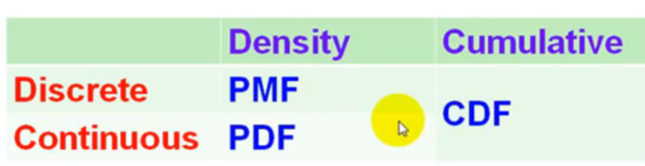
PMF vs PDF

Slide 2
PDF

Slide 3

PDF Example
Suppose you have variable x which is continuous random variable. So x is variable which is typically tells you the bus travel time from Bangalore to Hyderabad is 10 to 15 hours.
1) What is the probability that bus can reach next day in exactly 13 hours?
0(Values should be in range)
2. What is the probability that bus can reach next day in 11 -13hours

Slide 4
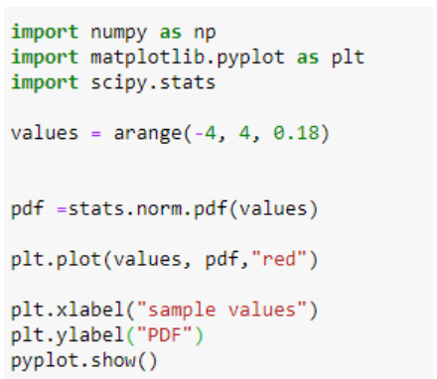
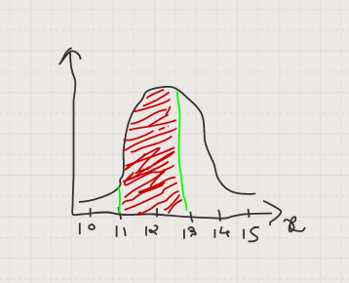
PDF

Slide 5
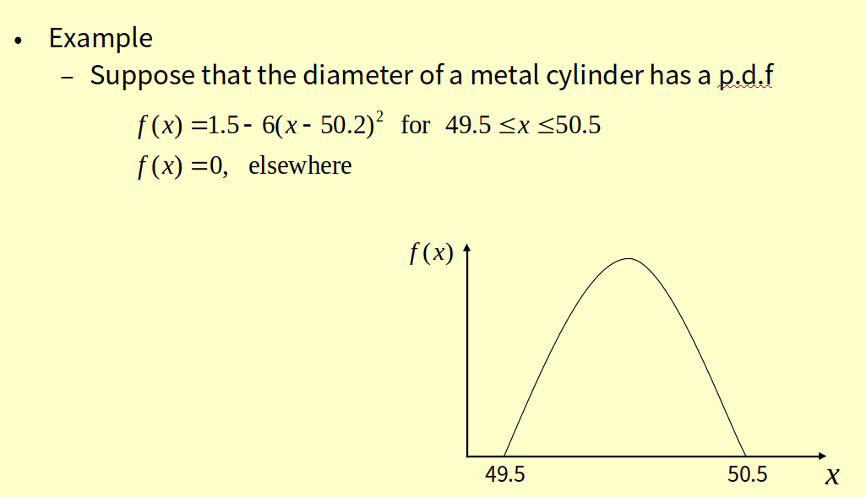
Example: P.D.F Cont...

Slide 6
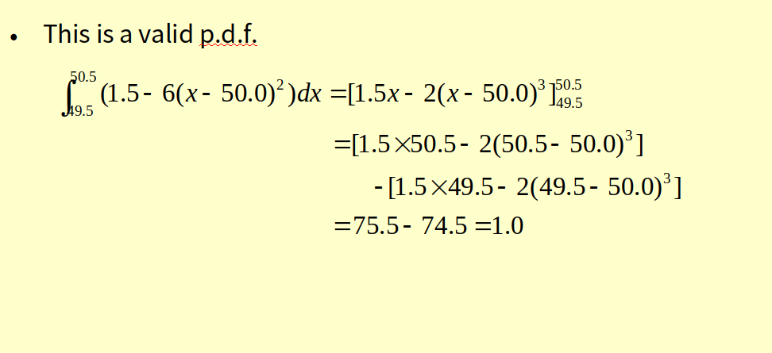
Example: P.D.F Cont...

Slide 7
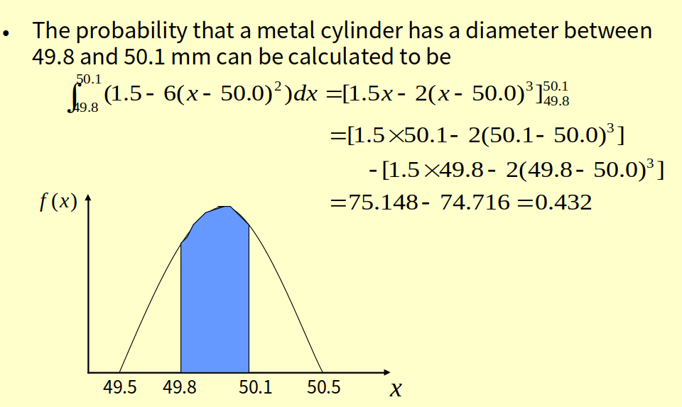
Example: P.D.F Cont...

Slide 8
Continuous case: “probability density function” (pdf)
p(x)=e^{-x}
1
x
The probability that x is any exact particular value (such as 1.9976) is 0; we can only assign probabilities to possible ranges of x.

Slide 9
For example, the probability of x falling within 1 to 2:
Clinical example: Survival times after lung transplant may roughly follow an exponential function.
Then, the probability that a patient will die in the second year after surgery (between years 1 and 2) is 23%.
p(x)=e^{-x}
1
x
1
2

Slide 10
3-4 Continuous Random Variables
3-4.1 Probability Density Function
The probability distribution or simply distribution of a random variable X is a description of the set of the probabilities associated with the possible values for X.

Slide 11
3-4 Continuous Random Variables
3-4.1 Probability Density Function

Slide 12
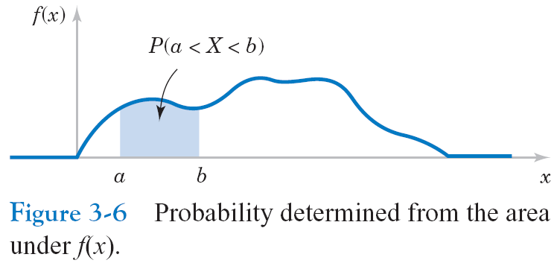
3-4 Continuous Random Variables
3-4.1 Probability Density Function

Slide 13
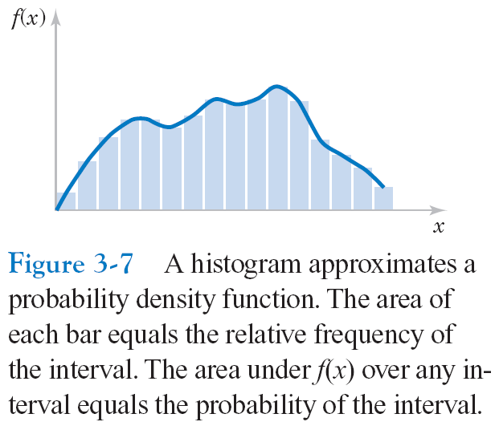
3-4 Continuous Random Variables
3-4.1 Probability Density Function

Slide 14
3-4 Continuous Random Variables
3-4.1 Probability Density Function

Slide 15
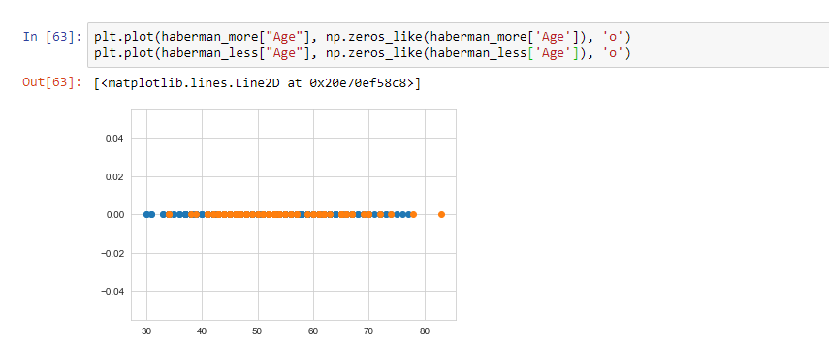
Applications of PDF in DS
I am using Haberman Dataset here which contains data from the study of patients who undergone surgery of breast cancer conducted in University of Chicago’s Billing Hospital between 1958 to 1970.By using this data(Data given are Age,Operation_Year and Axillary Nodes we want to know whether patient will die within 5 years or more than 5 years.Now lets plot Age variable here:

Slide 16
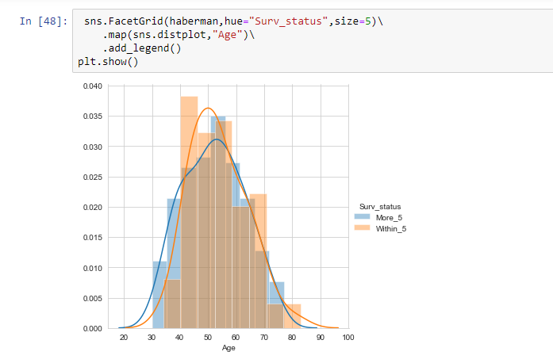
Cont..
This is called 1-D graph which is very hard to read because points are overlapping to each other.So to make easy visualization of this we break it into parts and count on Y-axis.Now what will se a bar like structure called histogram

Slide 17
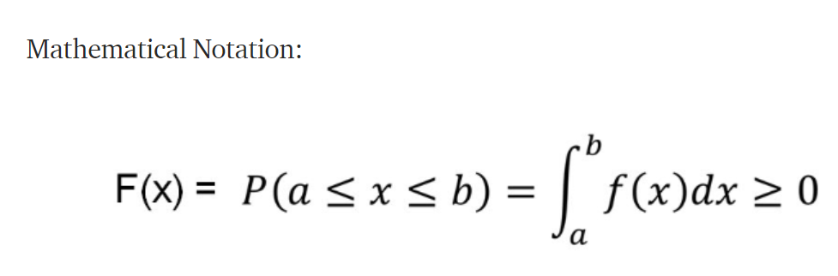
Cont..
After joining peaks of these different bars a smooth line is induced which is called PDF(Probability Density Function).Blue Line represents patients dying more than 5 years and Orange Line represents patients dying withing 5 years having surgery.So,PDF is version of histogram.
PDF is a statistical term that describes the probability distribution of the continuous random variable.

Slide 18
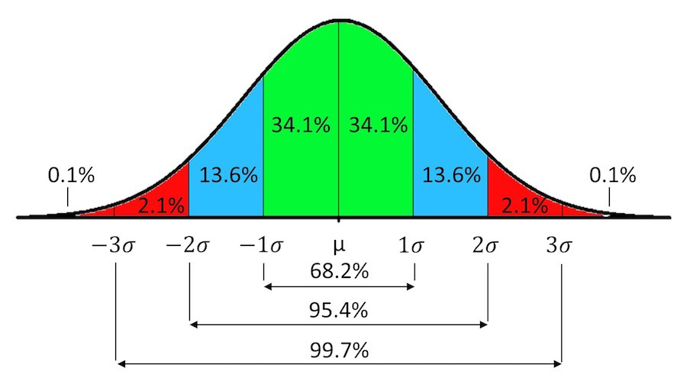
Cont..

Slide 19
CDF(Cumulative Distribution Function)
We have seen how to describe distributions for discrete and continuous random variables.Now what for both:
CDF is a concept which is used for describing the distribution of random variables either it is continuous or discrete.It is used to tell how much percentage of value is less than a particular value.
For Example : Lets take age variable from haberman dataset and now what i am writing is P(age=50) = 0.60.What it means that 60% of patients are less than age of 50 in dataset.

Slide 20
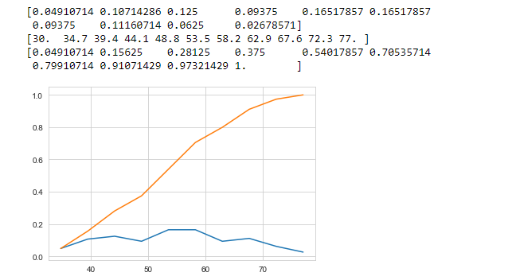
Cont..
Orange Line denotes CDF of Age variable.
In Short:
PDF (Describe’s distribution for continuous random variable) CDF(Describe’s distribution for continuous and discrete random variable).

Slide 21
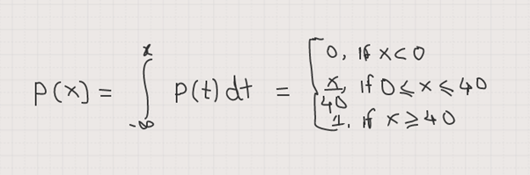
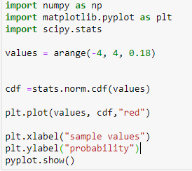
CDF
suppose there are 50 students in class with unique student id 1 to 40 & you want to pick one student from his ,so probability of getting student id 32 is p(32)= 32/40 i.e. 0.80

Slide 22
PDF vs CDF
Probability density function or pdf can be used to calculate the likelihood of a given observation in a distribution. It can also be used to summarize the likelihood of observations across the distribution’s sample space.
A Cumulative Density Function is a function that describes the probability of a random variable taking on a given value or less.
One question you guys may be have in your mind i.e which one is better for analysis , CDF or PDF .?

Slide 23
Contd…
How long users stays on a a certain website’, it may be good to show it in CDF as it shows the accumulated time he spent on that website, through the pages etc.
On the other hand, if you want to simply show the probability of users clicking on an advert link (e.g. Google ad-words link) then present it in PDF form as it will probably be a normal distribution bell curve and you can show the probability of that happening

